Slide 1
Real-time elastic Stream Processing model based on K8s
Zhuangwei Kang, Manyao Peng, Yingqi Li, Minhui Zhou

Slide 2
Intro
Stream Processing: a technology that performs data processing in motion i.e. computing data directly as it is produced or received
Applied areas: market feed processing and electrical trading in Wall Street, network and infrastructure monitoring, fraud detection, and command control in military environment, etc.
Real-time: guarantee response within specific time constraints.
Elastic: dynamically adapt based on different cost-benefit trade-offs e.g. scale in/out due to total utilization ratio

Slide 3
Intro
Scale in: remove some containers from VM nodes
Scale out: add more containers to VM nodes
K8s: Kubernete is a portable, extensible open-source platform for managing containerized workloads and services. It provides a container-centric management environment.
Can cluster together groups of hosts running Linux containers
Easily deploying and scaling containers
Cluster can span hosts across public, private and hybrid clouds.

Slide 4
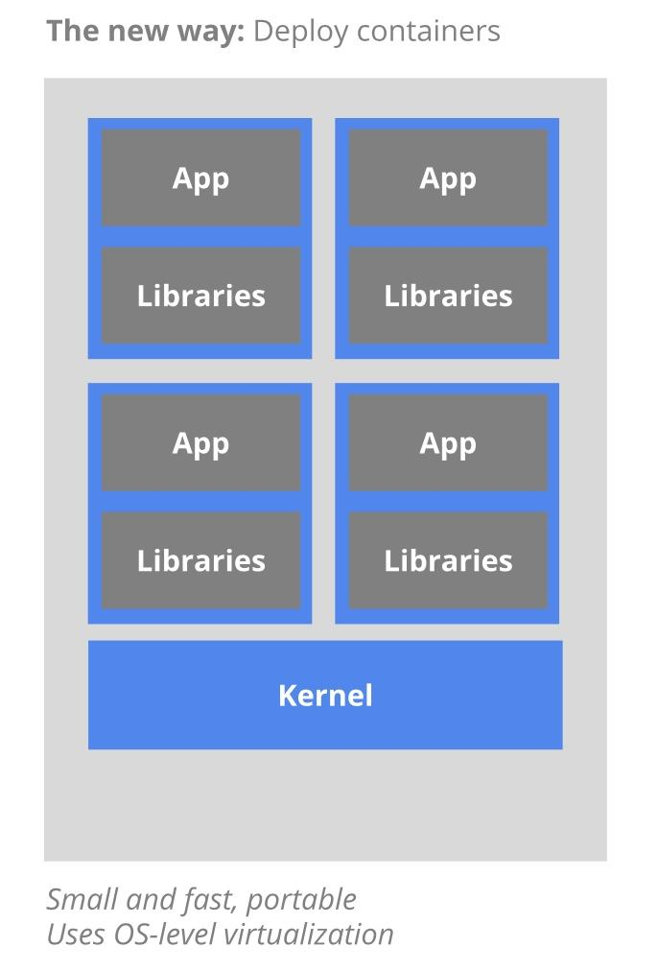
Intro
Container: the lowest level of a micro-service which holds the running application, the libraries and their dependencies.
Containers can be exported to the world through an external IP address.
Container Image: a binary that includes all of the requirements for running a single container, as well as metadata describing its need and capabilities.

Slide 5
Intro
Pod: a group of one or more containers with shared storage and network, and a specification of how to run the containers.
Pods are the smallest deployable units of computing that can be creating and managing in Kubernetes.
Node: a single virtual or physical machine in a Kubernete cluster.
Cluster: a group of nodes firewalled from the Internet, which are the primary compute resources.

Slide 6

Real-World Applications Powered by Stream Processing
Alibaba: Real-time Search Results on Singles’ Day

Slide 7
Real-World Applications Powered by Stream Processing
Alibaba: Real-time Search Results on Singles’ Day
Singles’ Day is China’s largest online shopping holiday, comparable to Black Friday and Cyber Monday in the United States but on an even larger scale.
User shopping behavior changes considerably on Singles’ Day.

Slide 8
Real-World Applications Powered by Stream Processing
Alibaba: Real-time Search Results on Singles’ Day
The Singles Day real-time big screen records the real-time gross merchandise volume.
Real-time analysis of a tremendous volume of continuous data inflow is often needed.

Slide 9
Real-World Applications Powered by Stream Processing
Alibaba: Real-time Search Results on Singles’ Day
The value of data could vanish immediately, or decline as time goes by.
So the response time required should be as short as possible.

Slide 10
Real-World Applications Powered by Stream Processing
Alibaba: Real-time Search Results on Singles’ Day
To address these challenges, Alibaba has developed its own real-time computing framework -- Blink.

Slide 11
Real-World Applications Powered by Stream Processing
Alibaba: Real-time Search Results on Singles’ Day
Blink bases on the true streaming approach, which considers a stream to be fundamental and treat batch as a special case of streaming (a finite stream).

Slide 12
Real-World Applications Powered by Stream Processing
Alibaba: Real-time Search Results on Singles’ Day
Why stream instead of batch?
We compare the difference between stream and batch:
The data handled by stream computing is indefinite, while batch computing is limited to a certain fixed data.

Slide 13
Real-World Applications Powered by Stream Processing
Alibaba: Real-time Search Results on Singles’ Day
Why stream instead of batch?
Using batch would require calculating the total sum after all transactions had closed.
Stream would trace transaction values in real time and conduct instantaneous computations, continuously updating the latest results.

Slide 14
Real-World Applications Powered by Stream Processing
Alibaba: Real-time Search Results on Singles’ Day
Why stream instead of batch?
Stream requires checkpoint assessment and a retainment of status, and can continue to run at high speeds during failover.
Batch input is sustained for a period and stored, so there is no cause for retaining status.

Slide 15
Real-World Applications Powered by Stream Processing
Alibaba: Real-time Search Results on Singles’ Day
Why stream instead of batch?
Stream is a pre-estimation of a final result requiring a retraction of computations done in advance to make further amendments.
Batch does not require the retraction process.

Slide 16
Real-World Applications Powered by Stream Processing
Alibaba: Real-time Search Results Ranking on Singles’ Day
Big Screen inspiration:
1. Calculates the total GMV in USD.
2. Calculates GMV from Mobile.
3. Calculates Cross-Border Commerce.
4. Ranks countries/regions with completed transactions.

Slide 17
Real-World Applications Powered by Stream Processing
What we will design -- A real-time merchandise volume calculator
Calculate the gross sales number of each province in China per second
Calculate average sales number per order of each province in China per second

Slide 18
Real-World Applications Powered by Stream Processing
How we will implement
We focus on elastic property of the stream processing.
We use Kubernetes to provide a container-centric management environment.

Slide 19
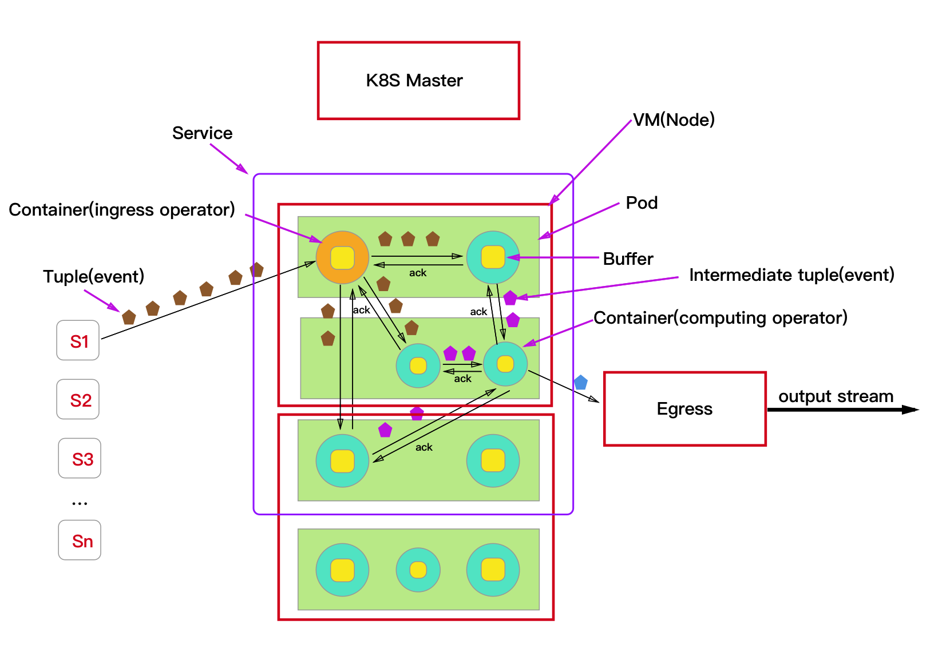
General System Architecture
Notes:
Pod: A Pod represents a running process on your cluster. A Pod encapsulates an application container (or, in some cases, multiple containers), storage resources, a unique network IP, and options that govern how the container(s) should run.
Service: A Kubernetes Service is an abstraction which defines a logical set of Pods and a policy by which to access them -sometimes called a micro-service.
Ingress operator: An ingress operator gets input data from source.
Egress operator: An egress operator forwards the result to the top-most operator.
Tuple: Tuple is the unit of input data that is composed of timestamp and data.
S: Data source

Slide 20
How does our system work in normal case?
Ingress operator gets input data from data source;
Ingress operator immediately distributes data to multiple computing operators; BTW, we may use a load balancer(like HAproxy) here. Ingress maintain a buffer, whenever ingress receives tuple, it stores timestamp+tuple in buffer and maintains the data until it receives ack message from downstream computing operators;
Computing operators start computation work as long as they receive new tuples; computing operators also maintain a buffer for fault-tolerance (we will discuss it later). After computation, computing operator transfer the intermediate tuple to downstream operator.
Finally, egress operator receives the result and transfers it to output.

Slide 21
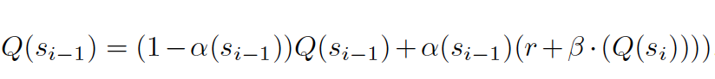
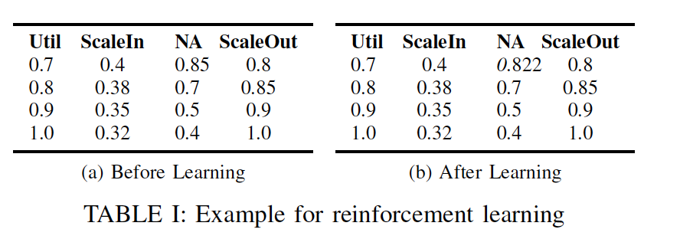
How to implement auto-scaling in our system?
High system utilization rate & low end-to-end delays can’t be obtained at the same time.
Our auto-scaling strategy: Reinforcement learning (Sarsa Algorithm)
Our idea is making K8s master node maintains a lookup table for each node, and master node needs to measure the utilization of worker node every once in a while. The lookup table is used for deciding which action to take based on historical feedback. After master node making decision, it choose an action to modify the cluster scale.
For scaling in, master can just build new container to increase system throughput.
For scaling out, master node would check if any other node has enough capacity of handle the container that has lowest resource utilization. If so, our idea is using container live migration to migrate the container to new node. If not, master gives up scaling out.
System always chooses the action that has the highest reward value.
Sarsa updates the reward for the previous state and action Q(si-1) based on an immediate reward r and the expected future reward for the current state Q(si) :
å( si-1) and ß are learning factors describing the influence of the
immediate and the future reward respectively. And r is the immediate
Reward.
r= 1 + |(last measured utilization - target utilization)/target utilization|
-|(current measured utilization-target utilization)/target utilization|
Notes:
A table entry describes for a given utilization value the expected reward value for different actions. Possible actions include scale out, scale in and no action.
Sarsa updates the reward for the previous state and action Q(si-1) based on an immediate reward r and the expected future reward for the current state Q(si) .

Slide 22
Others
Data may be out of order due to delay, our rough idea to handle this problem is using a time window and a delay pardon mechanism. But we think we still need to do more research.
We plan to use the ReplicationController in K8s to implement fault-tolerance in our system to achieve high availability feature.
Because we are new to stream processing, there must be lots of shortcomings in our designed architecture.

Slide 23

Thanks!
Author:
Manyao, Peng
Yingqi, Li
Minhui, Zhou
Zhuangwei, Kang

